Slide 1


Welcome to The Startup Action Pitch Deck Template!
Hi, I’m Melinda Elmborg, a former startup investor turned startup coach. I help founders build and grow their startup using the strategies previously only known to serial entrepreneurs.
Great job on downloading this template! With this deck template you’ll be able to get into more investor meetings and raise the capital you need!

Slide 2
Intro to The Startup Action Deck Template
I started my career at the French VC firm Daphni. It’s a fund with $180M under management investing in seed and series A startups. As a part of the investment team, I studied on average 20 decks per week. After a while, I realized which decks that stand out and get the investment team’s attention.
In this template I share the best slides so YOU can stand out in the pile of decks that investors receive.
This deck template is a teaser that you send out to investors to introduce yourself or ahead of a scheduled meeting. The number 1 goal for this deck is that you tease the investors so they become interested and want to meet you.
This teaser deck answers the first questions that the investors are asking themselves as they open a deck
for the first time:
What are they doing? (Market and/or type of technology) The investors want to know if it’s within their scope.
What proof do they have that they can succeed with this? (Show metrics, traction and team achievements)
How big could this be? (Market size and business model)
A seed investment has NEVER been done based on a deck, it’s always based on how excited you make the investor feel and the relationship that you develop during the investment process. That relationship can only develop when spending time together. This deck is the stepping stone to get into meetings with more investors!

Slide 3
Overview of The Startup Action Deck Template
1. Sexy One Liner 2. Problem 3. Solution 4. Metrics/Traction | 5. Market 6. Business Model 7. Team 8. The Ask
Visual elements are always better than text since it let’s your message come across faster and more efficiently. In this template, there are plenty of examples of how to visually present your information.
In terms of design, the following slide templates are just an example. I decided on 1 type of font and 2 colors that work together, and then I stuck to that theme throughout the deck. You should do the same; stay consistent in your design with your brand colors and font. If you don’t have an eye for design, ask a friend who is good at that to redesign the deck for you.
No matter your brand profile, the number 1 rule is to keep your deck very airy. NO cramped slides, please!
A teaser deck should be preferably 10 slides, maximum 15 (including first and last slide). In this template you will find all the mandatory slides, but it might be that your startup requires more explanations on certain points so you might add a few slides.
Keep in mind, that on average, an investor spends only 3 min on your deck. DO NOT include long texts or explanations. Maximum 30 words per slide.

Slide 4

The Sexy One-Liner
This is the first thing that the investors see when they open your deck. The goal here is to get the investor to lean in.
On the first slide, you should already help the investor understand what you’re doing and answer the first question they have in their heads by including your sexy one-liner.
The sexy one-liner explains which market you operate in and how you disrupt that market. Hyped words such as “AI, deep tech, IoT”, etc. are very welcome here.
“Makes the healthcare sector efficient with technology”
“Replaces real estate agents with algorithms”
“Equipes HR with smart AI”

Slide 5
1. Sexy One-Liner
LOGO
Bringing AI to Hospitality

Slide 6
The Problem
Before explaining what your product does, you want to set the scene and explain why there is a need for your product.
Why should the investor care about your product?
This slide is especially important if you are solving a problem that might not be well-known to the investor. Think about the profile of the typical investors you meet, how familiar is the investor with this problem?
The best here is if you can refer to a global problem that your product will fix. Investors like to help solve problems for humanity. Otherwise, you can also
explain the pain that your customers experience if they don’t have your product.
You always want to use data to make the pain you explain irrefutable. Very few startups do that so here you can really stand out.
The data that you share can either come from market reports or interviews/surveys that you’ve done with potential customers. Don’t forget to link or explain how you discovered the findings.
Pick one of the following two options for your Problem Slide:

Slide 7

Admin in the Healthcare System Costs $5 Billion Every Year to Taxpayers
2. Problem, option 1
25 % of working hours in the healthcare system are spent on administration.
Only in France, that costs the taxpayers €5 billion per year.
25%
Admin
75 %
Patient meetings
Source: XYZ

Slide 8
Staff Turnover is a Costly Problem in the Hospitality Industry
2. Problem, option 2
Staff turnover is considered the no. 1 problem by 68% of managers
$12 K/year in losses For an average hospitality company
No tool To easily manage and increase staff engagement
Sources: XYZ.com/report, survey of 53 hotel owners in France
Notes:
Problem Option 1

Slide 9
Your Solution
When you present your product you want to give the investor the feeling that it’s live and currently in use, that’s why it’s really good to use screenshots from your product.
Best-in-class is if you can use the template from option 1 here. You need to make the explanation of your product extremely straightforward in this phase of the investment process so the investors can feel like they “get it”. Your product is probably more complicated and has lots of fancy features, but it’s not the place to explain those here.
If you right now have a simple MVP that doesn’t at all represent what you want the platform to do in the future, you can do what template option 2 shows here.
When you explain your product, the rule is simple: Show is always better than tell. Use pictures, arrows and symbols to your advantage.
Pick one of the following two options:

Slide 10

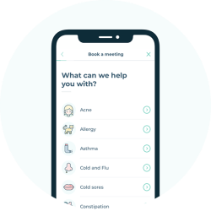

Three Easy Steps for Physicians to Work from Home
3. Solution, option 1
Create profile
2. Receive bookings
3. Meet patients online
Notes:
Solution Option 1

Slide 11
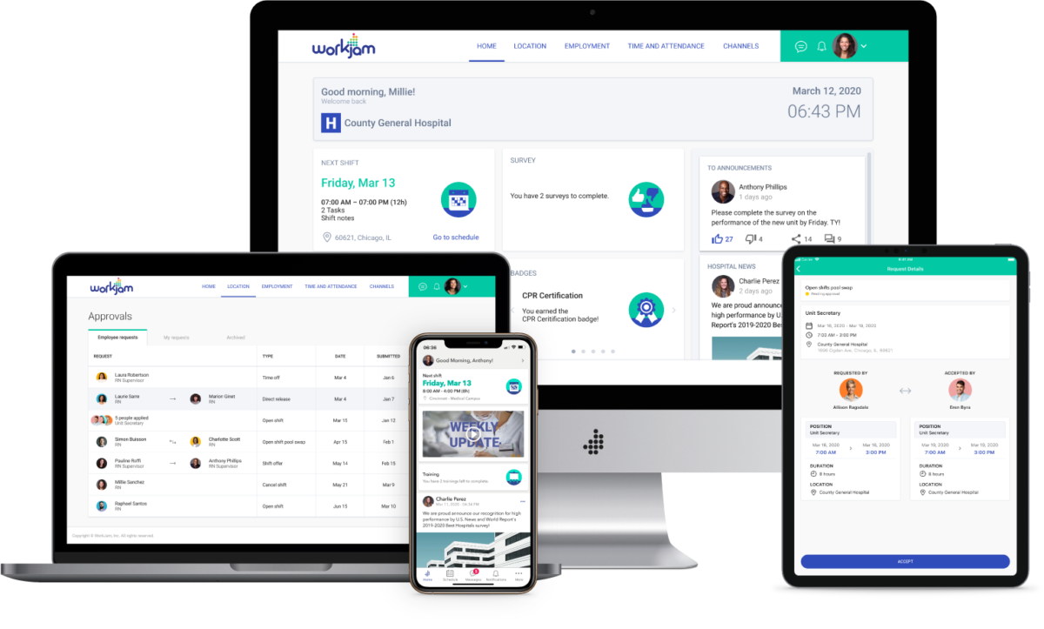
Our Platform Automates Processes for Clinics and Hospitals
3. Solution, option 2 (for future rich products)
TODAY
Patient bookings
VISION
Visits by video
Invoicing and payments
Automated follow ups
Messaging between professionals
Notes:
Solution Option 2

Slide 12
Metrics or Traction
When the investor gets what your startup does, it’s time to share some proof that you are successful in doing this. If you haven’t yet launched, you need to show that you will be successful as soon as you get the product out on the market.
The best is if you can put a growth chart here--a chart that is pointing upwards to the right. You’ve got three options for metrics to show your growth:
Revenue (or MRR if you offer subscriptions, or GMV if you have a take-rate)
Number of actions taken by your users on your platform
The number of active users
If your line is not as straight as in the following
examples, it’s ok. That is not necessary when you’re raising a seed round. However, your growth per month needs to be 10 % or more on average.
If you don’t have any metrics in your company that are growing 10 % or more month-over-month, you can look at other metrics that are impressive. The next best would be to present a flattened retention curve, or something else that shows how people who start using your product love it and keep on using it.
If you don’t yet have users, you need to show traction and potential some other way. See option 4. You can instead brag about any waitlist or quotes from interviews.

Slide 13
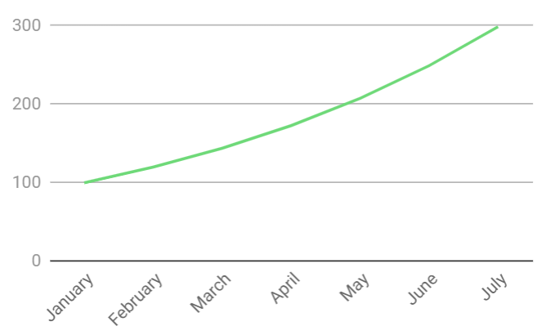
Average 20 % Month-over-Month Growth in Bookings
4. Metrics, option 1 (marketplace and e-commerce)
Consistent month-over-month growth achieved with proven marketing channels and strong retention.
60 % of users come back for a second booking within 4 weeks.
Notes:
Metrics Option 1 - Marketplace or transactions

Slide 14
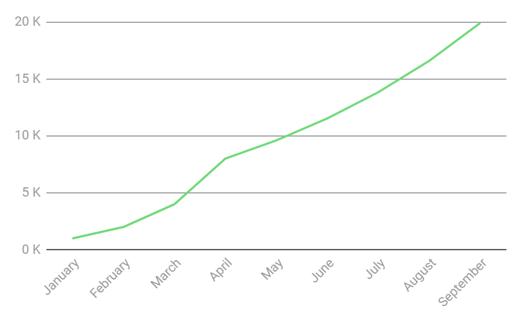








Quickly Growing MRR with a Strong Pipeline of Customers
4. Metrics, option 2 (B2B Saas with ARR and pilots)
MRR
Average contract valued at $3 000.
5 signed pilot contracts, total worth of $15 000 in MRR.
In discussions with C-level at Coca-Cola, Nestlé and Arla for pilots starting in September.
*
* forecast
Notes:
Metrics Option 2 - B2B Saas

Slide 15
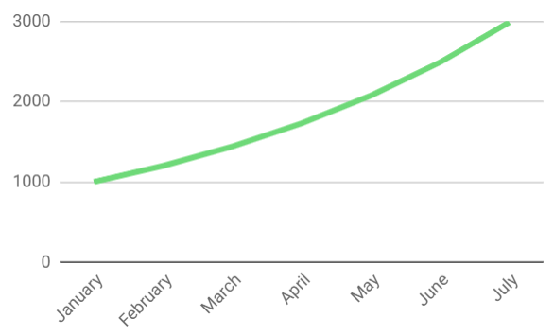
3x Number of Monthly Active Users in 6 months
4. Metrics, option 3 (consumer app)
Consistent 20% month-on-month growth achieved through organic channels.
8 weeks retention rate is 30 %.
MAU
Notes:
Metrics Option 3 - Consumer App

Slide 16


315 Physicians Have Signed Up To Our Waitlist
28 Interviews Conducted With Physicians
4. Metrics, option 4 (Show traction pre-launch)
“I hate administration. Can’t wait to get my hands on your product!” Dr. Jenny Tang, GP at Mountain Hospital
“As the owner of a clinic, administration is a huge cost. I would be happy to pay for a solution that solves that headache” Dr. George Smith, ENT Specialist and Founder of City Clinic
Notes:
Add more relevant quotes if possible

Slide 17
The Market
There is a framework that all VC investors use, and you should apply that here. It’s called the TAM, SAM, SOM.
TAM - Total Addressable Market This is the market that you’re operating within. So for example that could be the retail market, the healthcare market, or the hospitality market. You want it to be worth at least $1 billion. But if you discover that it is hundreds of billions, that’s really good!
SAM - Serviceable Addressable Market Find this by cutting out a first segment of your market; for example, the retail market becomes the e-commerce market.
SOM - Serviceable Obtainable Market
Do a second segmentation so that you have the estimate of the current market that you focus on first. For example, the global e-commerce market becomes the European e-commerce market.
Either you can present your TAM, SAM, SOM in value ($) or you can put it in number of transactions or users on your market. If you do the latter, your SOM estimation can be used in your business model slides.
Bonus points if the market is also growing. Then please include that, as seen in the template:

Slide 18
A Large and Growing Market
5. Market Size
Global Number of Physicians
10 million
+ 5% per year
Global Number of Specialist Surgeons
1.1 million
+ 6% per year
Number of Specialist Surgeons in the US
200 000
+ 7 % per year
Source: XYZ
Notes:
Metrics Option 4 - Show Traction Pre-launch
Add more relevant quotes if possible

Slide 19

The Business Model
In this slide, you explain how you earn money. It is great if you not only explain the revenue part, but also explain how that business model comes together with your market estimation as seen in the two following examples.
If you are not yet sure how you will monetize, you can either list your different ideas for monetization or show the first business model you were thinking of implementing.
Please note that it’s Important to arrive at the number of $100 million or more of potential revenue. $100 million is the revenue a startup usually needs to be valued at $1 billion--in other words, to be a unicorn.

Slide 20
The SaaS Model Adapted to our “Land and Expand” Strategy
6. Business Model, option 1 (B2B saas)
Two Available Plans:
$ 990 per year for individual physicians
$ 490 per year per physician for clinics and hospitals
$990
20 000
$490
180 000
$ 100 million yearly revenue
(individual specialist surgeons in the US)
(Specialist surgeons at clinics/hospitals in the US)
Notes:
Business Model Option 1 - Subscription model

Slide 21
A Business Model Made to Scale
6. Business Model, option 2 (marketplace)
We take a 10 % commission on each booking
10.6M
$200M
$20
Trips with AB&B
Avg Fee $70 x 3 nights
Revenue
Notes:
Borrowed from Airbnb: very interesting that their revenue in 2019 was actually 4 billion!

Slide 22

The Team
The most common error by founders for their team slide is not bragging enough. The investors might have no clue of who you are, you need to tell them!
Don’t just put the name and the picture of everyone in your team. An investor has no idea if a team is good or bad based on your name and your serious face…
For every person you include:
Picture
Role and name
Any achievements as previous founders or employees
Any logos that the investor might recognize (if anyone in the team has previously done a successful exit as founder or worked at a well-known and successful startup, investors usually wet their pants out of excitement…! Yes I’m serious!)

Slide 23

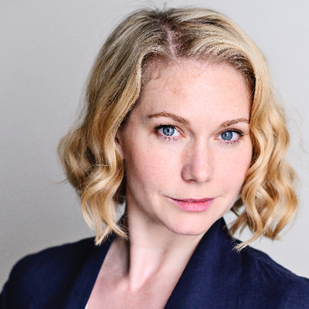







An Experienced and Dedicated Team
7. Team
CEO Albert Samson
Experienced Project Manager. Scaled a new business line from $1M to $50M in revenue.
CPO Anna Carlos
Previous Product Manager at Google. Increased revenue per user with 50 %.
CTO Phoebe Chen
Previous CTO at the startup FoodyTech, which was acquired for $50M.
Advisor Chris Cooper, PhD
Previous CEO, experienced board member in the food industry.
Notes:
Business Model Option 2 - marketplace or transactions (borrowed from Airbnb)

Slide 24

The Ask
In this slide you tell the investor how much you want to raise and very briefly what you want to achieve with this. This also allows for them to see if the investment you’re seeking is within their scope.
At this stage in the process you don’t need to explain too many details. When you meet, you will talk in greater detail about how you will deploy the capital and reach the goal. Remember that this is a teaser, this is only to make them interested in talking to you.

Slide 25
We Are Looking to Raise $1M
To Reach 5 000 customers
8. The Ask
Notes:
Add more relevant quotes if possible

Slide 26
Contact CEO Albert Samson albert@flimsy.com
Final slide
LOGO
Notes:
Metrics Option 3 - Consumer App

